Slide 1

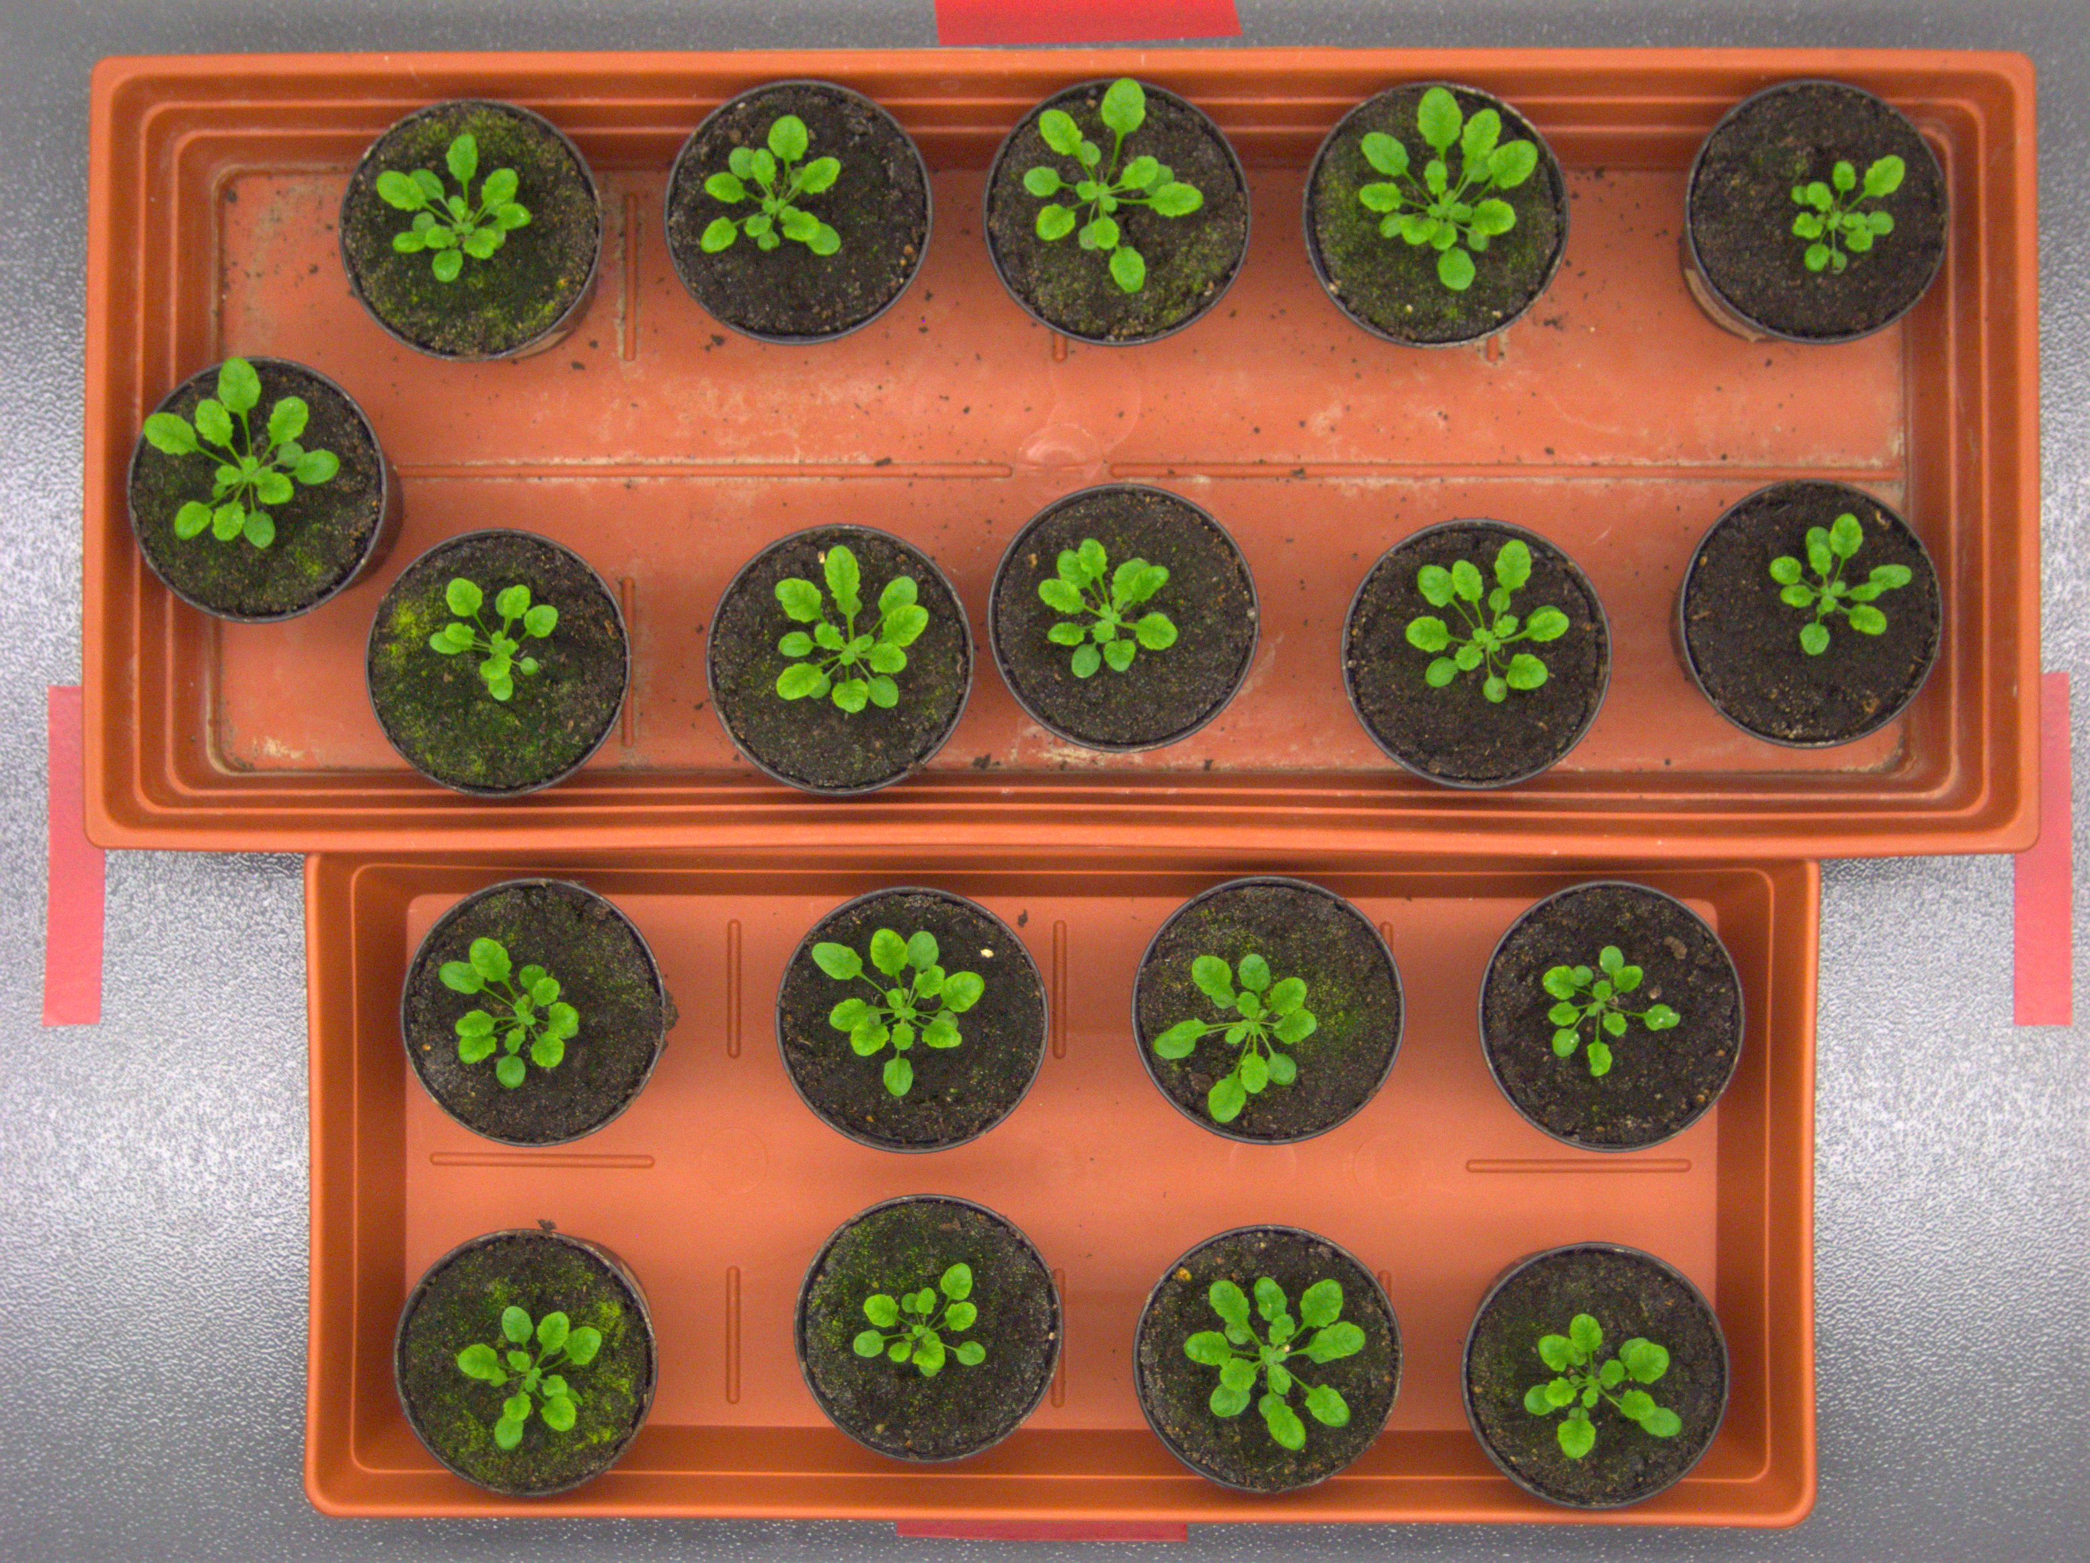
Plant Phenotype Analysis
Group E

Slide 2
Task Definition
Task1 - object identification
Detect every plant in a given test image, draw bounding boxes around each of them and display the total number of plants in the image.
Task2 - plant segmentation
Find the projected leaf area by segmenting the plant from its background.
Task3 - individual leaf segmentation
Use deep learning method to identify the leaf from plants.

Slide 3
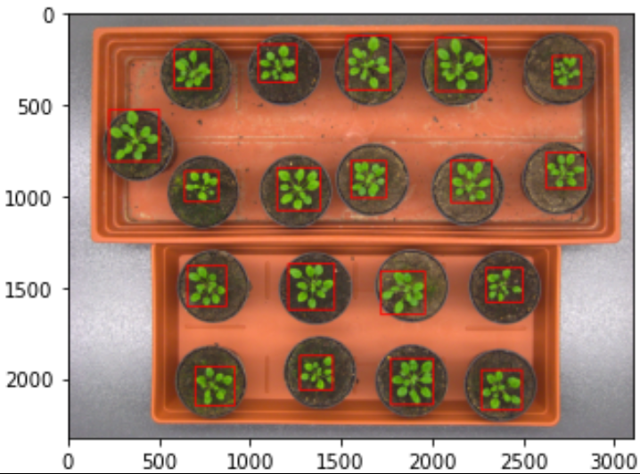
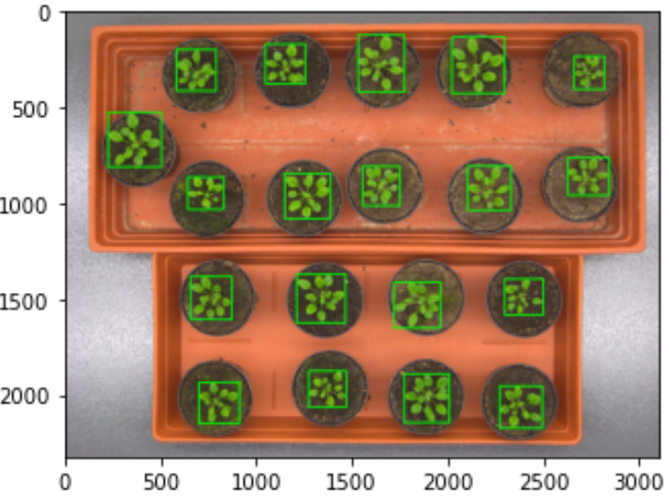
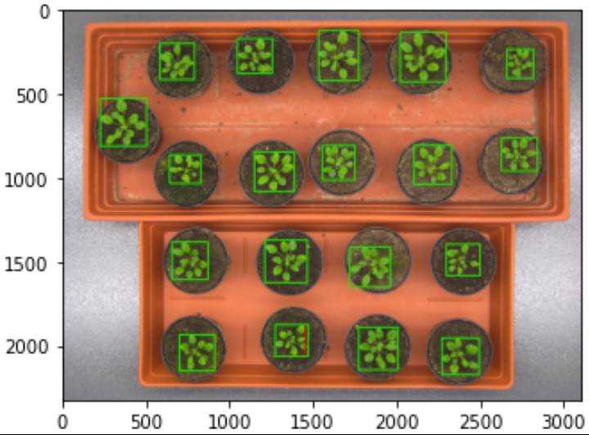
Task 1 – Plant localization
Pre-processing:
Covert image into LAB colour Space
Feature Extraction:
Separate plant from background using a threshold. Plant is green, background is not
Generate regions using contours and edge detection
Use region merging with boundary boxes
Evaluation:
Normalize image
Use Average Precision to evaluate algorithm: TP/(TP + FP)
Ground truth
Generated
Overlayed

Slide 4
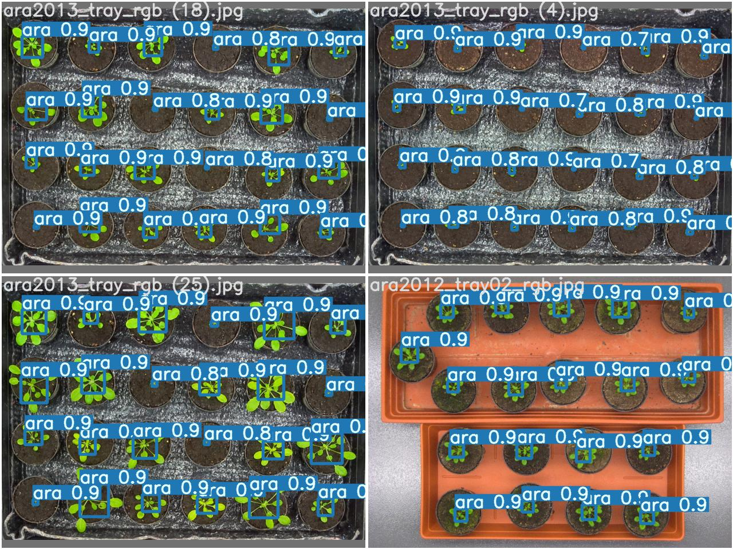
Task 1 – Other attempts
Use HSV colour Space:
The same idea with LAB colour space.
Lower precision than LAB method
Use YOLO model:
One stage algorithm
High precision at counting plants
Bad at drawing boxes
YOLO

Slide 5
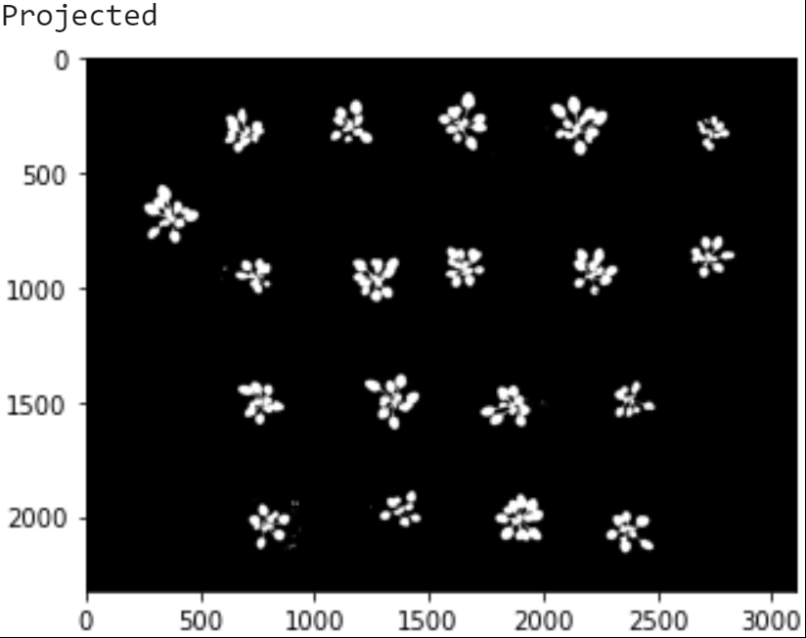
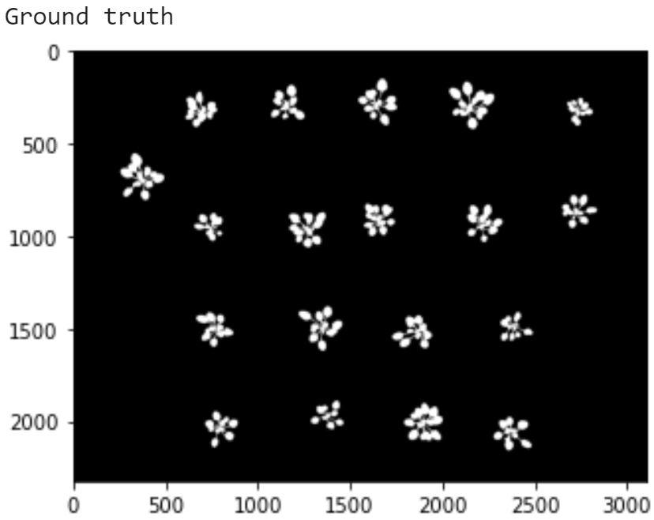
Task 2 – Projected Leaf Area
Pre-processing & Feature Extraction:
Same as Task1
Evaluation:
Normalize image
Use Dice Similarity coefficient to evaluate algorithm: (2*TP)/(2*TP + FP + FN)
Use Intersection over Union to evaluate algorithm: TP/(TP+FP+FN)

Slide 6
Evaluation & Result
Method | Task1 Precision | Task2 dice value | Task2 iou value
LAB | 0.889 | 0.960 | 0.923
HSV | 0.828 | 0.852 | 0.751
YOLO | 0.997 at counting | - | -
LAB+YOLO | ? | ? | ?

Slide 7
Conclusion
…

